Slide 1
Applications of Dynamic Linear Models
Mark Scheuerell
FISH 507 – Applied Time Series Analysis
2 February 2017

Slide 2
Why use a DLM?
DLMs are useful if/when:
The underlying level (intercept) changes over time (eg, flow of the Nile R)

Slide 3
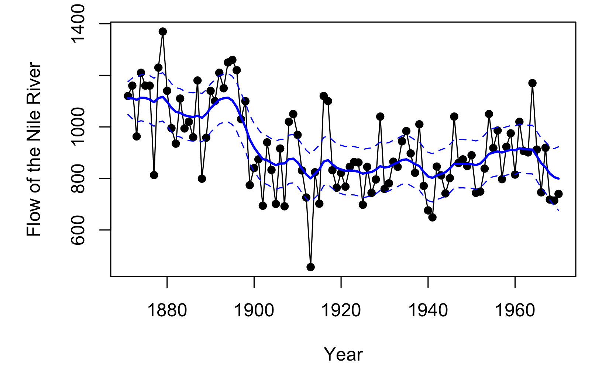
DLM for changing level (intercept)

Slide 4
Why use a DLM?
DLMs are useful if/when:
The underlying level (intercept) changes over time (eg, flow of the Nile R)
The underlying growth (bias) changes over time (eg, PCB’s in L Michigan salmonids)

Slide 5
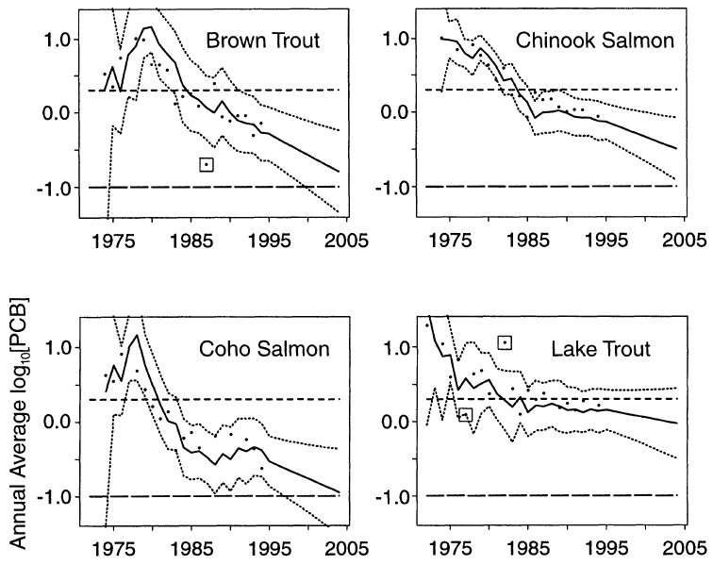
DLM with changing growth (bias)
Lamon et al. (1998) Ecol. Appl.

Slide 6
Why use a DLM?
DLMs are useful if/when:
The underlying level (intercept) changes over time (eg, flow of the Nile R)
The underlying growth (bias) changes over time (eg, PCB’s in L Michigan salmonids)
The relationship between the response and predictor (slope) changes over time (eg, effect of upwelling on salmon survival)

Slide 7
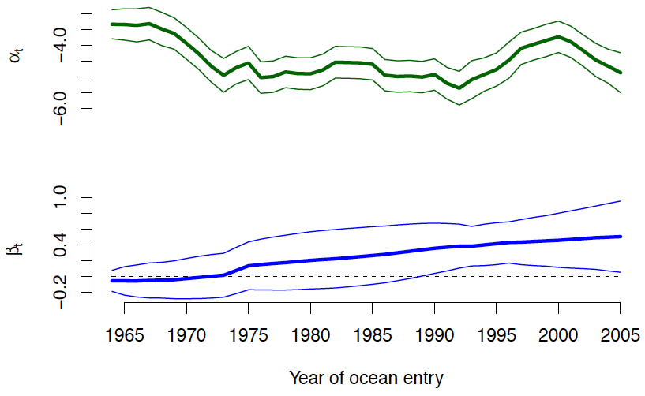
DLM with changing effect (slope)
Scheuerell & Williams (2005) Fish. Ocean.

Slide 8
From finance to fisheries:
Using market models to evaluate returns versus risk for ESA-listed Pacific salmon
Mark Scheuerell
NOAA Northwest Fisheries Science Center
Jennifer Griffiths
Stockholm University
Eli Holmes
NOAA Northwest Fisheries Science Center

Slide 9
Notions of risk in finance
Financial markets are rife with various forms of risk
For simplicity, let’s consider 2 broad categories:
Systematic (market) risk is vulnerability to large-scale events or outcomes that affect entire markets
(eg, natural disasters, govt policy, terrorism)
Unsystematic (asset) risk is specific to particular securities or industries
(eg, droughts affect commodities like corn, but not oil; bad batteries affect Boeing, but not Microsoft)

Slide 10
Diversification
By holding a diverse collection of assets (a portfolio), one can reduce unsystematic, but not systematic, risk
Investing is inherently risky, but (rationale) investors are risk averse
That is, if presented with 2 portfolios offering equal returns, they should choose the less risky one
Thus, investors expect to be compensated with higher returns for accepting more risk & vice-versa

Slide 11
Estimating risks
Portfolios can only reduce unsystematic risks, so one should understand the systematic risk of an asset before it is added to a portfolio
Sharpe (1963) outlined a model whereby returns of various assets are related through a combination of a common underlying influence & random factors
Total risk = Systematic risk + Unsystematic risk

Slide 12
The market model
Many others (e.g., Treynor, Lintner, Beja) were also working on these ideas, which ultimately led to the “market model”
Returns of asset
at time t
Returns of market
at time t
Manager’s skill
Correlated volatility
(sensitivity to systematic risk)

Slide 13
Interpreting alpha
Value of α | Interpretation
α < 0 | Asset earns too little for its risk
α = 0 | Asset earns about expected for its risk
α > 0 | Asset earns in excess given its risk
*
*Expected value if market is “efficient” (sensu Fama 1970)

Slide 14
Interpreting beta
Value of β | Interpretation | Example
β = 0 | Movement of asset is independent of market | Fixed-yield bond
0 < β < 1 | Movement of asset is in the same direction as, but less than movement of the market | Consumer “staple” stock
β = 1 | Movement of asset is exactly the same direction & magnitude of the market | Representative stock
β > 1 | Movement of asset is in the same direction as, but more than movement of the market | Tech stock

Slide 15
Capital Asset Pricing Model (CAPM)
CAPM followed directly from the market model
CAPM determines an expected rate of return necessary for an asset to be included in a portfolio based on:
the asset's responsiveness to systematic risk (β);
the expected return of the market; and
the expected return of a risk-free asset (eg, US govt T-bills)
CAPM is usually expressed via the security market line:

Slide 16
Security market line (SML)
E(r_{a})
E(r_{a}) = r_{f} + [E(r_{m}) - r_{f}]β_{a}
slope: E(r_{m}) - r_{f}
intercept: r_{f}
β_{a}

Slide 17
Security market line
E(r_{a})
β_{a}

Slide 18
Security market line
E(r_{a})
Undervalued
Overvalued
β_{a}

Slide 19
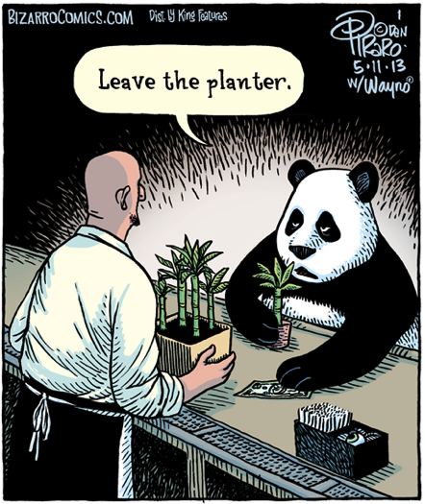
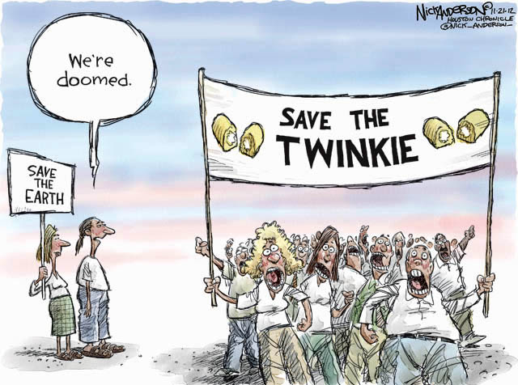
Ecological analogues
Many ecologists study “risk” & “returns” in a conservation context

Slide 20

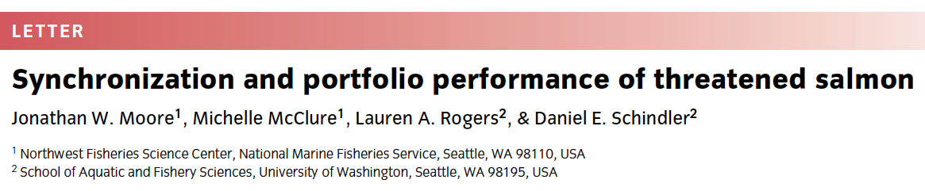

Portfolio ideas in nature

Slide 21


Slide 22
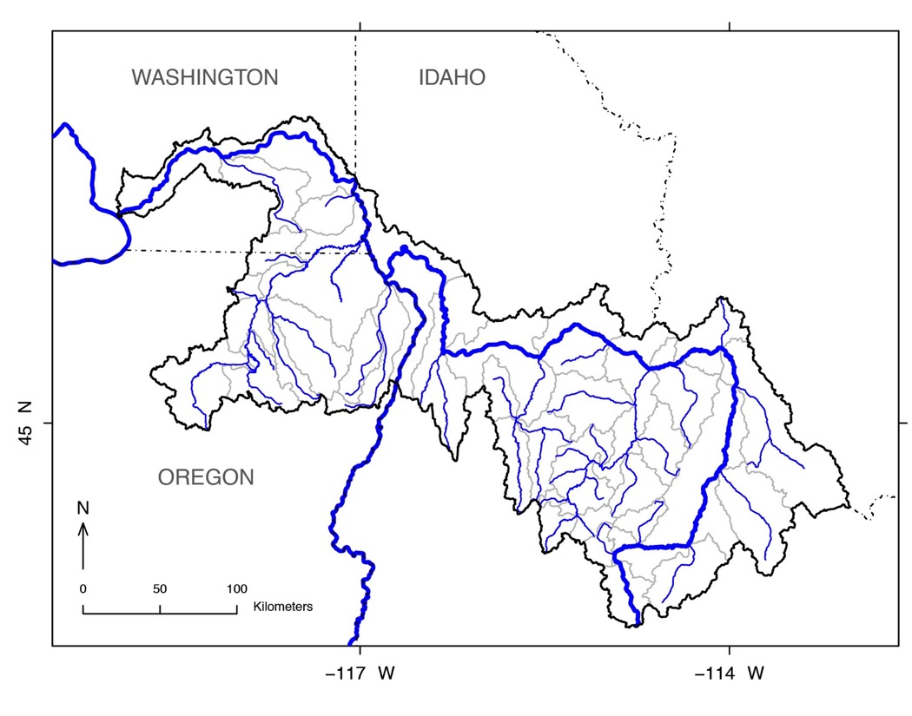
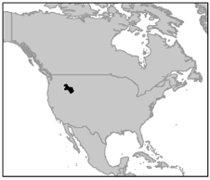
Snake R spring/summer Chinook

Slide 23
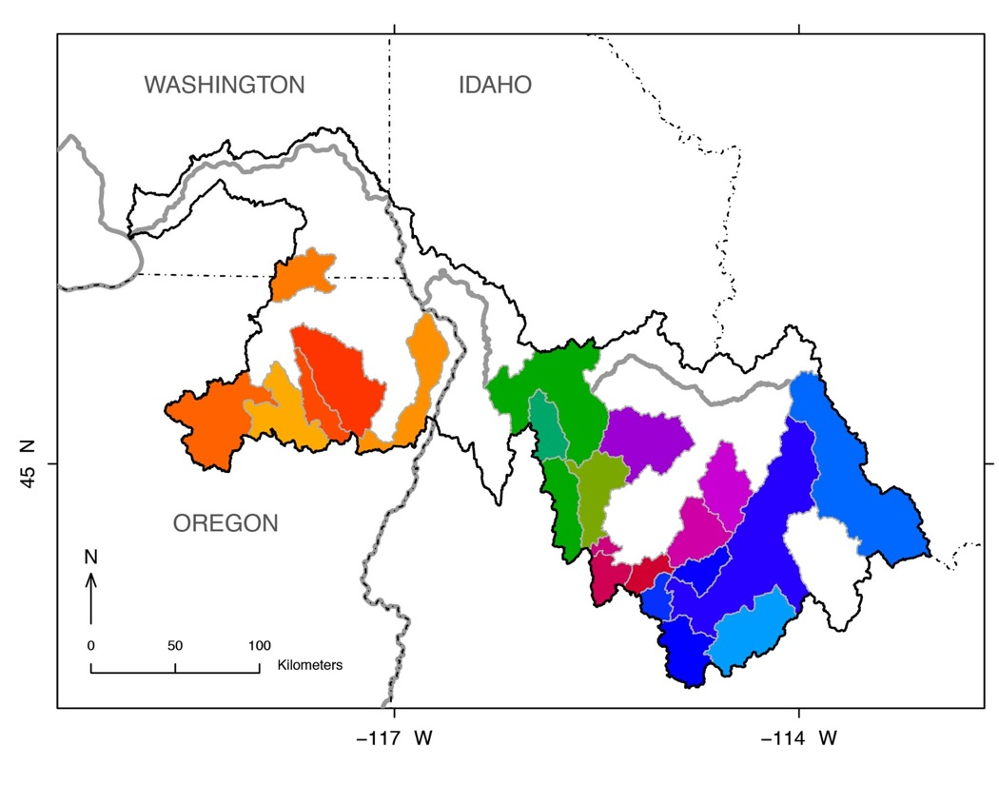
Snake R spring/summer Chinook

Slide 24
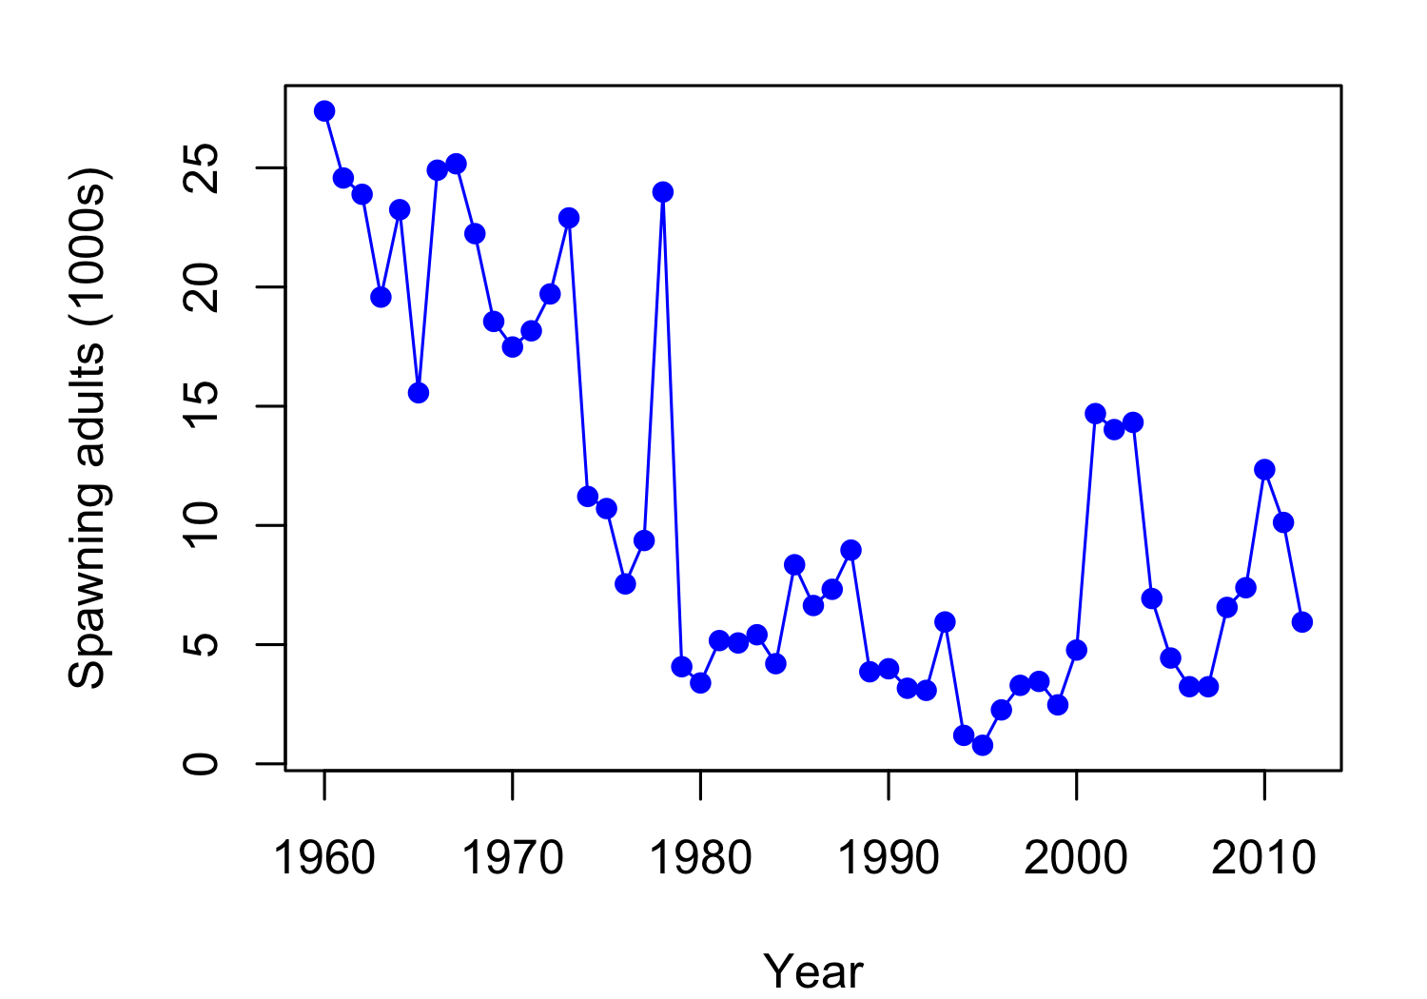
Time series of abundance
In 1992 listed as “threatened” under ESA

Slide 25
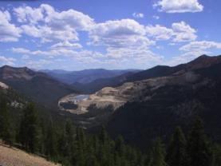
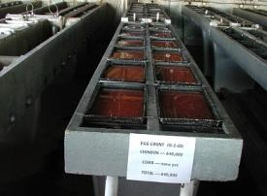

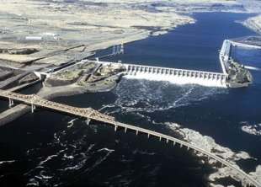
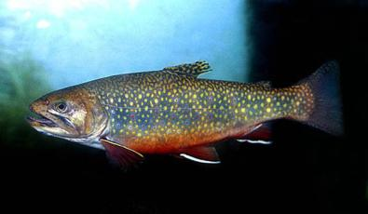

Reasons for decline
Harvest
Habitat degradation
Hatchery operations
Hydroelectric (& other) dams
Climate
Non-native species
Marine-derived nutrients

Slide 26
What are the recovery options?
Recovery based on 4 “viable salmon” criteria:
Productivity
Abundance
Spatial structure
Diversity

Slide 27
Asset, market & risk-free indices
Assets
ln[Recruits/Spawner] (productivity)
ln[Spawners/ha] (abundance)

Slide 28

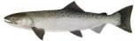
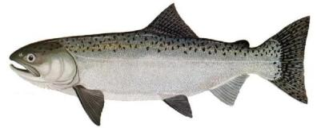
Salmon life cycle
Freshwater
Eggs incubate over winter
Parr rear in streams
Adults spawn & die in spring & summer
Smolts emigrate to sea in spring
Grow at sea for 1-5 yrs
Ocean

Slide 29
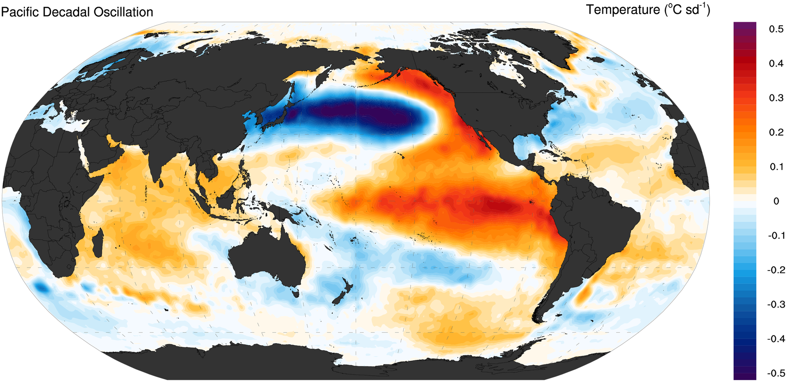
The Pacific Decadal Oscillation
See Mantua et al. (1997) Bull. Am. Meteor. Soc.

Slide 30
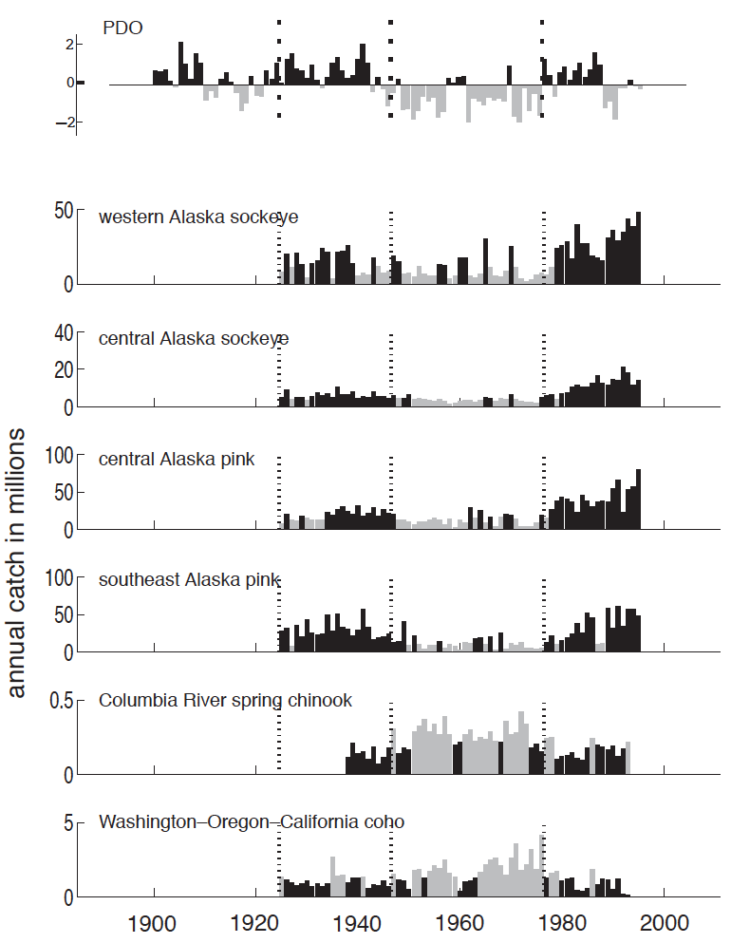
The Pacific Decadal Oscillation
2 take-home messages:
Salmon production related to ocean conditions
The PDO is a pretty good indicator of lg-scale forcing
See Mantua et al. (1997) Bull. Am. Meteor. Soc.

Slide 31
Asset, market & risk-free indices
Assets
ln[Recruits/Spawner] (productivity)
ln[Spawners/ha] (abundance)
Market
Pacific Decadal Oscillation (PDO)
in brood yr + 2
Risk-free
Replacement (ln[R/S] = 0)
ln[R/S] of John Day popn

Slide 32
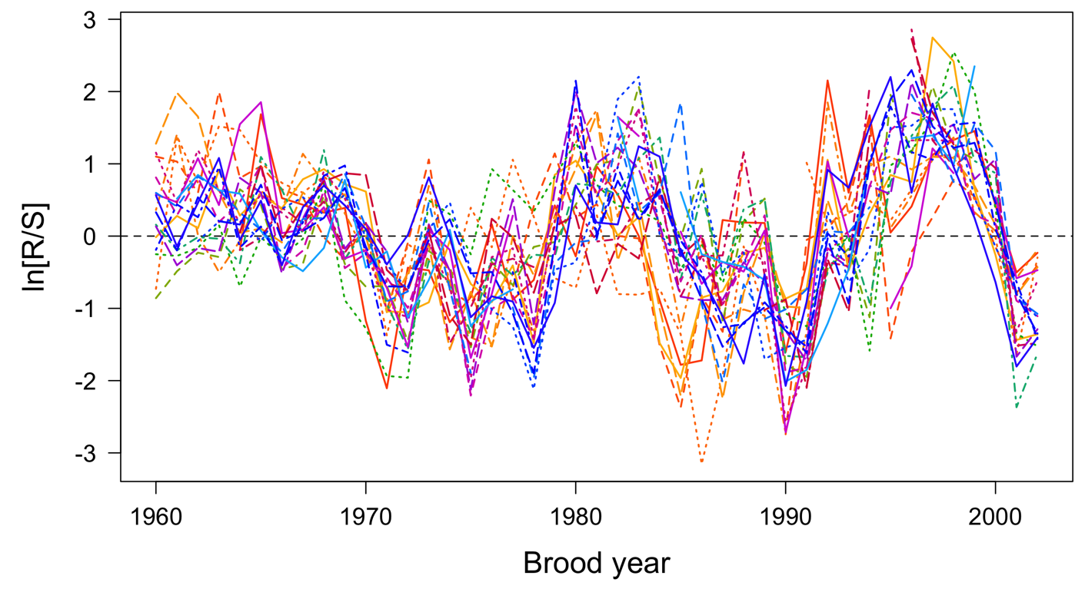
Time series of “returns”

Slide 33
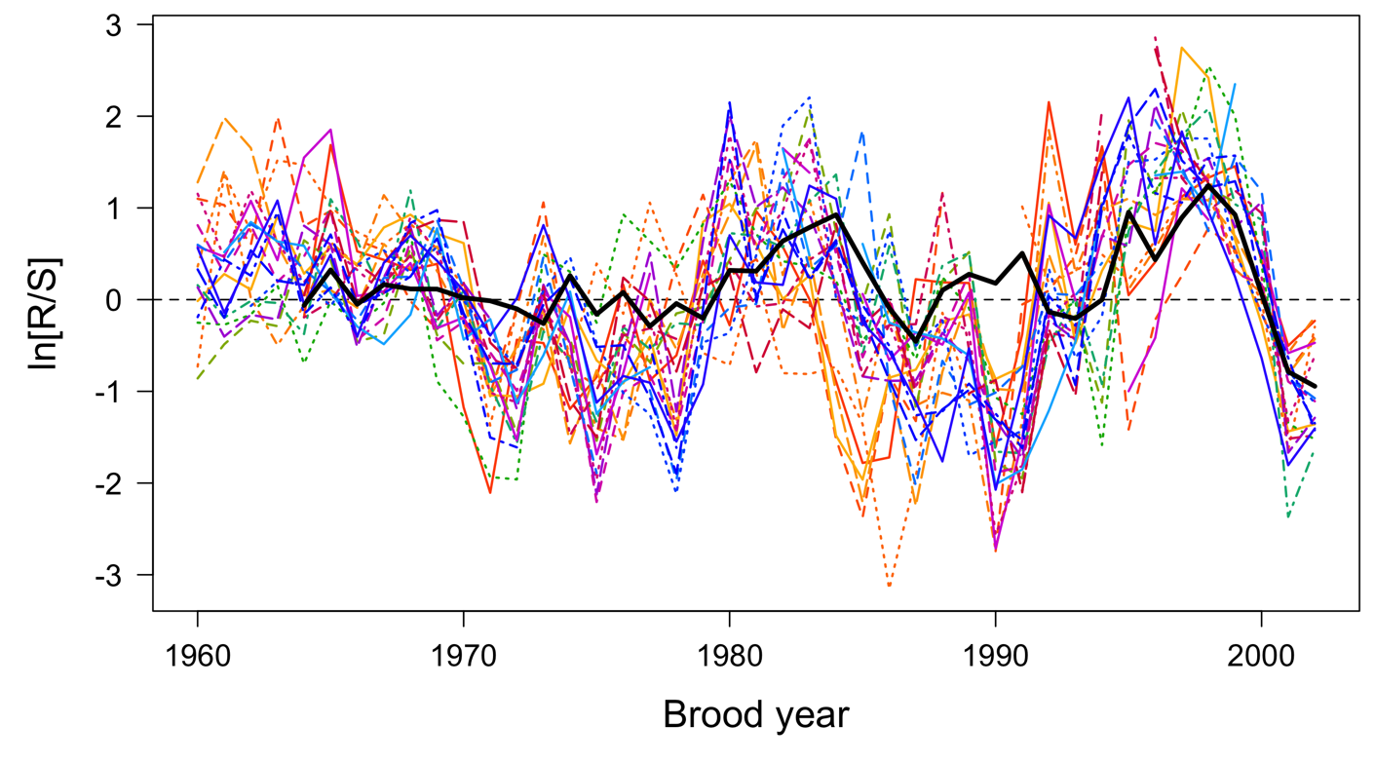
Time series of returns & risk-free

Slide 34
Fitting the market model
In practice, the errors are often assumed to be Gaussian, and the model is solved via ordinary least squares
This works well if the underlying relationship between asset & market is constant, but that rarely holds
One option is to pass a moving window through the data, but window size affects accuracy & precision of β
Better choice is to use a dynamic linear model (DLM)

Slide 35
Snake R spr/sum Chinook ESU

Slide 36
Multivariate DLM
Here we will examine multiple assets at once, so we need a multivariate (response) DLM
First, the obs eqn
becomes

Slide 37
Multivariate DLM – obs eqn
=

Slide 38
Multivariate DLM – obs eqn
=
+

Slide 39
Multivariate DLM – evolution eqn
The evolution eqn
becomes

Slide 40
Multivariate DLM – evolution eqn
=
+

Slide 41
Multivariate DLM – evolution eqn

Slide 42
Time series of “returns”

Slide 43
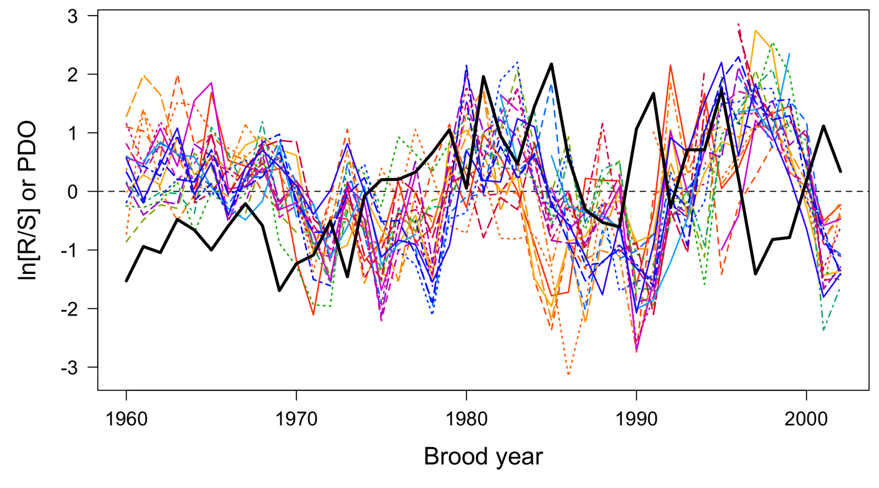
Time series of “returns” & PDO

Slide 44
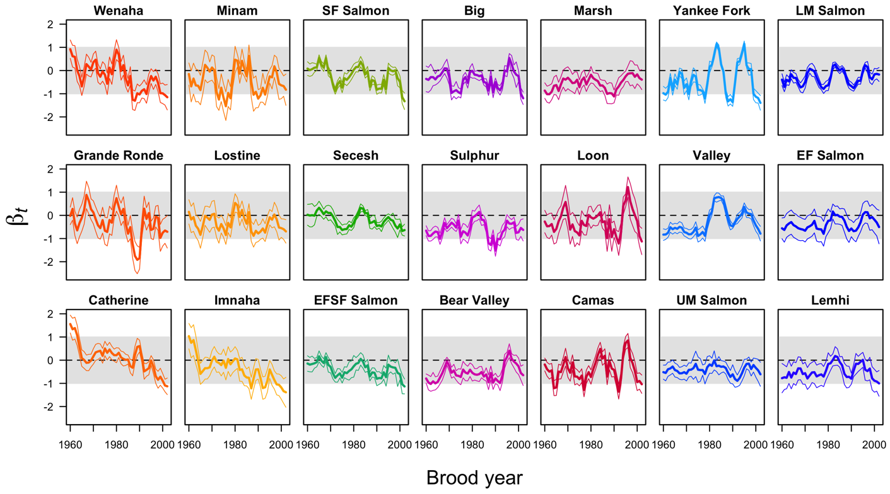
Results – time series of betas
Market = PDO

Slide 45
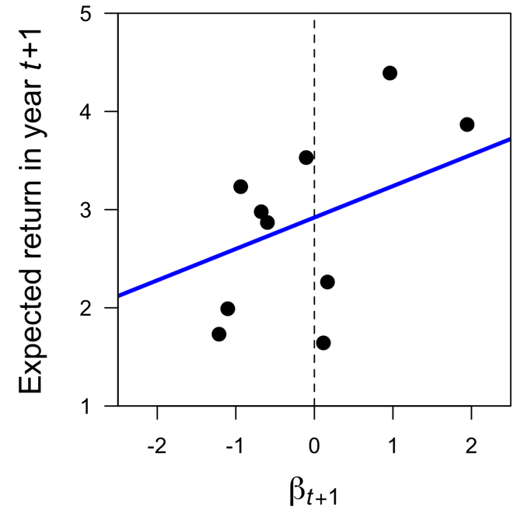
Security market line

Slide 46
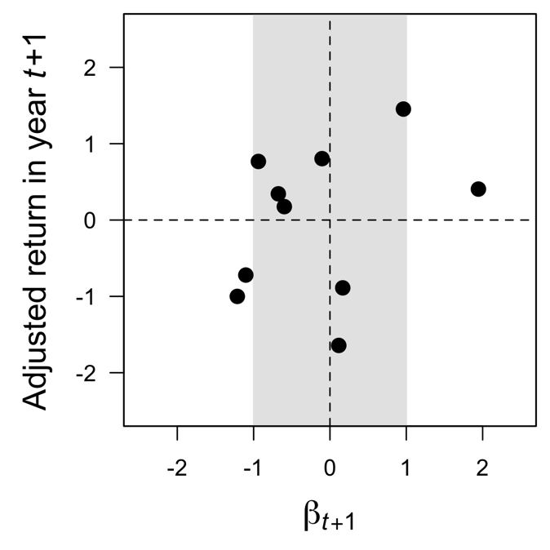
Security market line

Slide 47
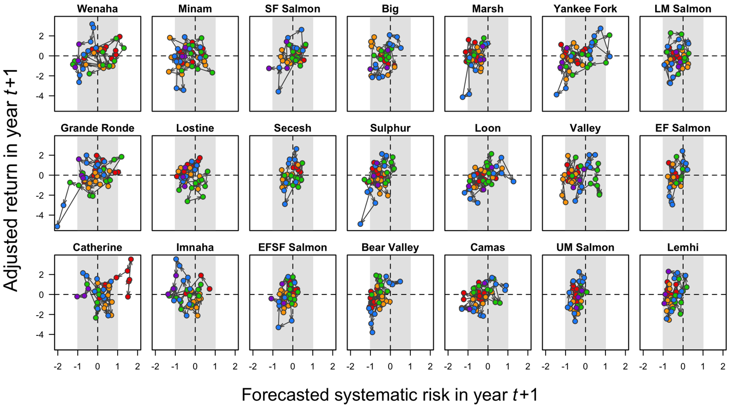
Results – CAPM
1960s
1970s
1980s
1990s
2000s
Market = PDO; Risk-free = 0

Slide 48
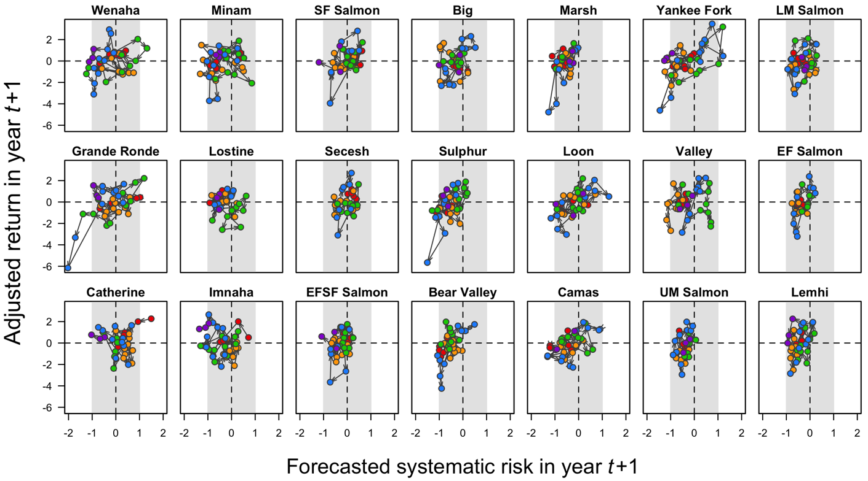
Results – CAPM
1960s
1970s
1980s
1990s
2000s
Market = PDO; Risk-free = John Day

Slide 49
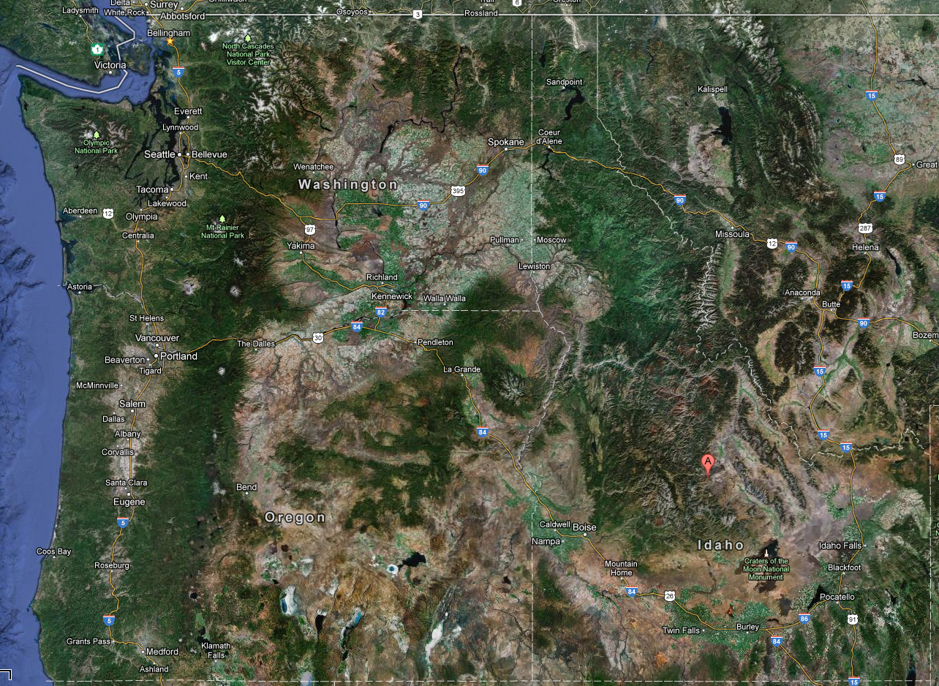
Image by Google

Slide 50
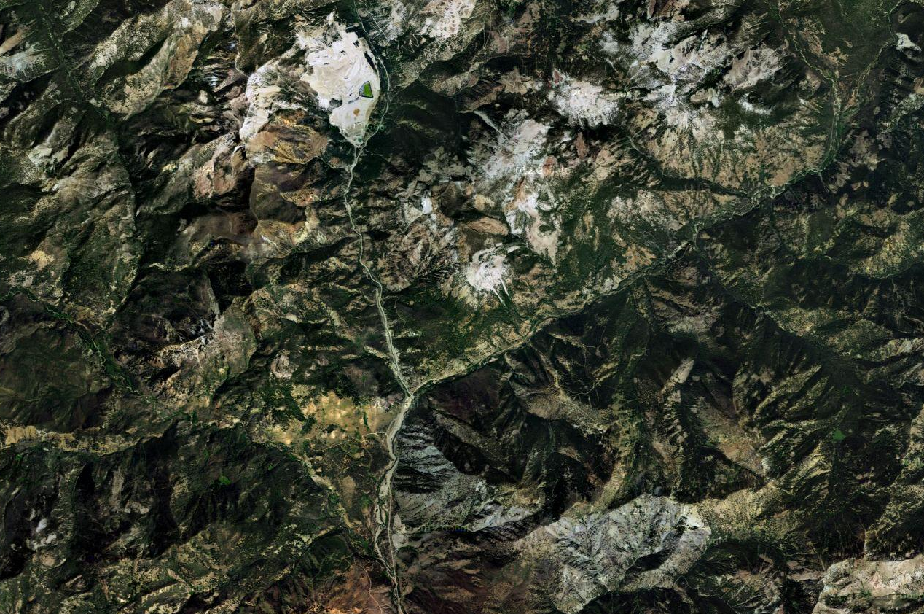
Image by Google

Slide 51
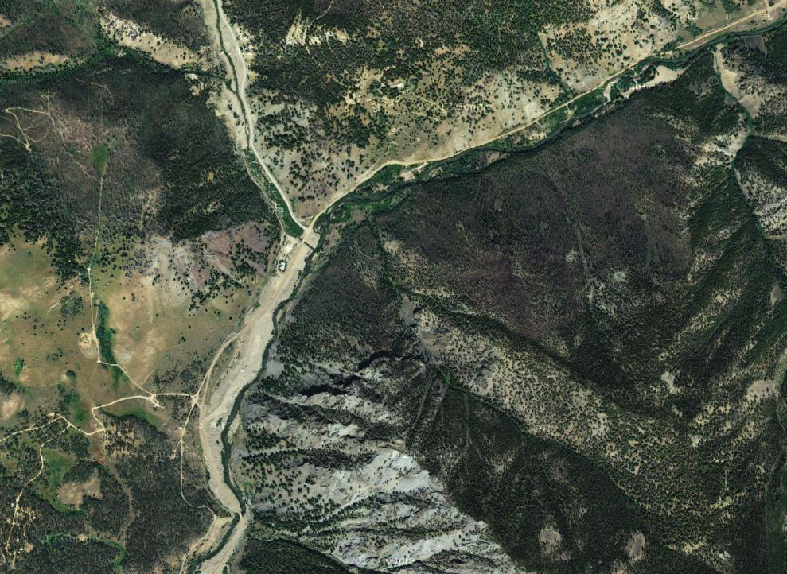
Image by Google

Slide 52
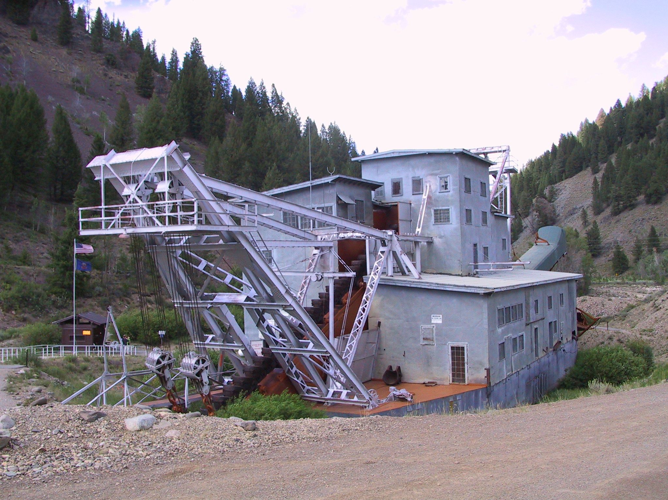
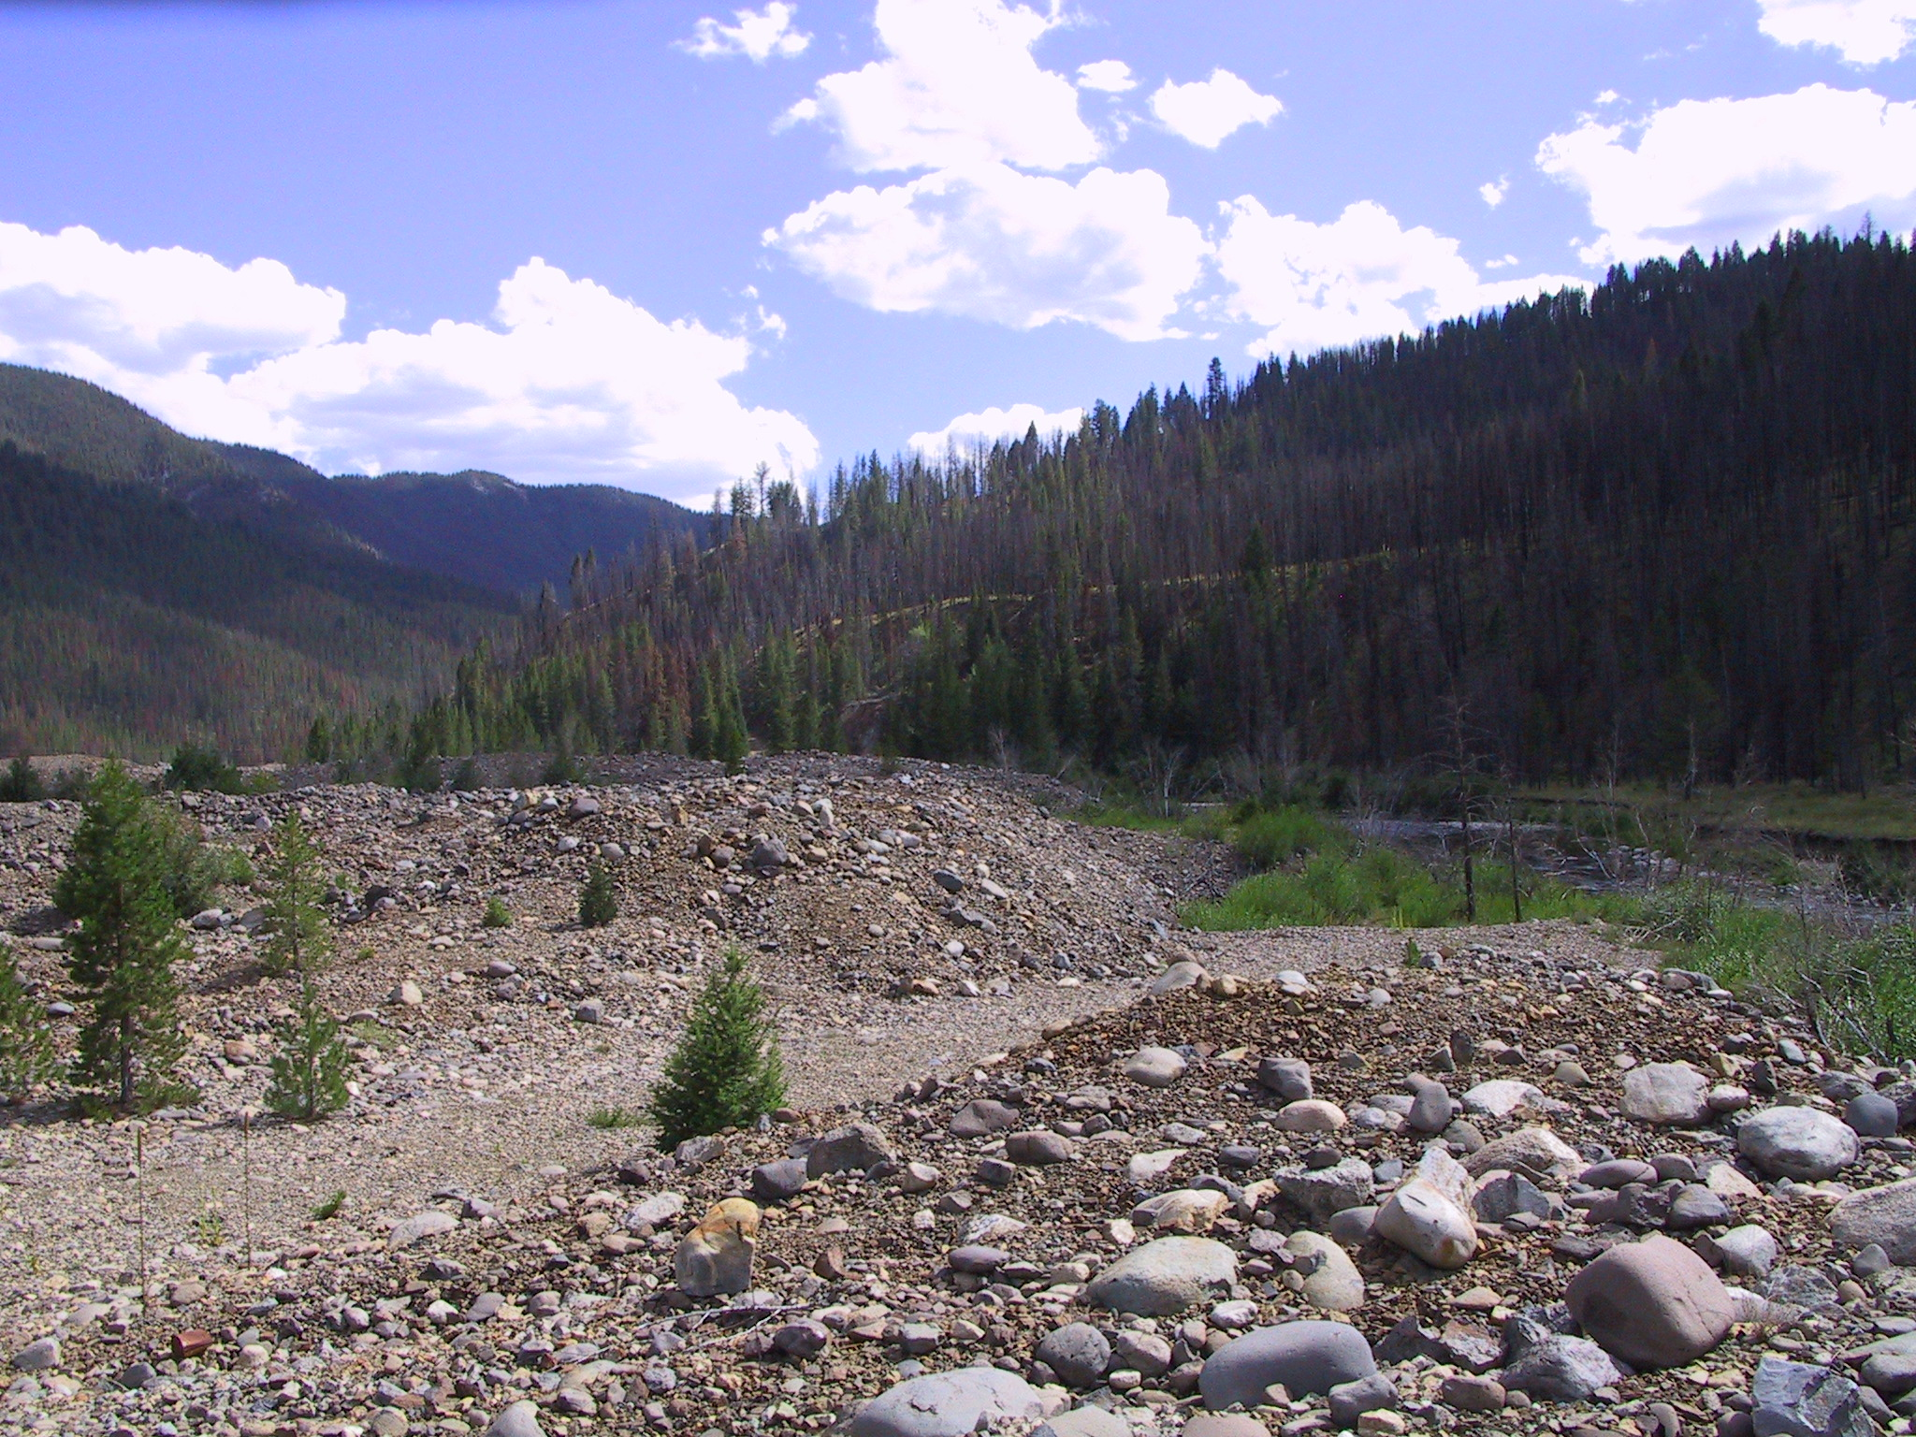

Slide 54
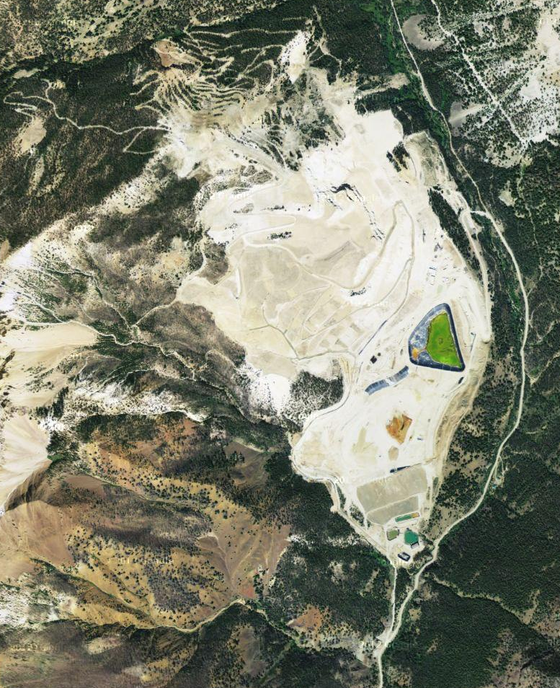

Slide 55


Slide 56

Photo by Jack Molan

Slide 57
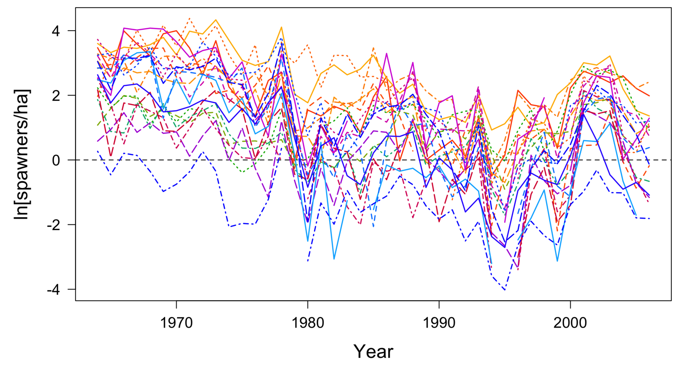
Time series of returns (Density)

Slide 58
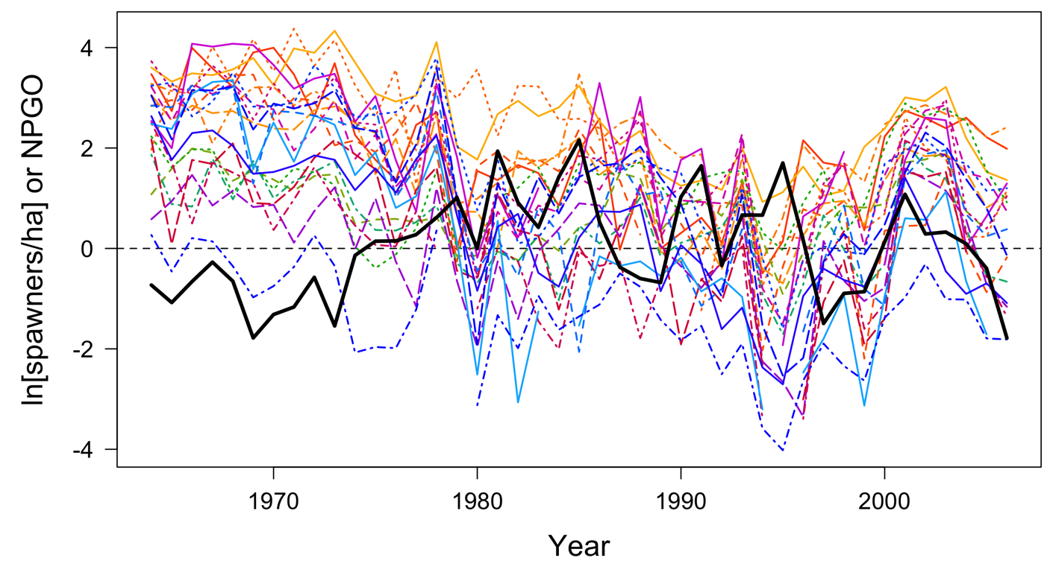
Time series of returns & PDO

Slide 59
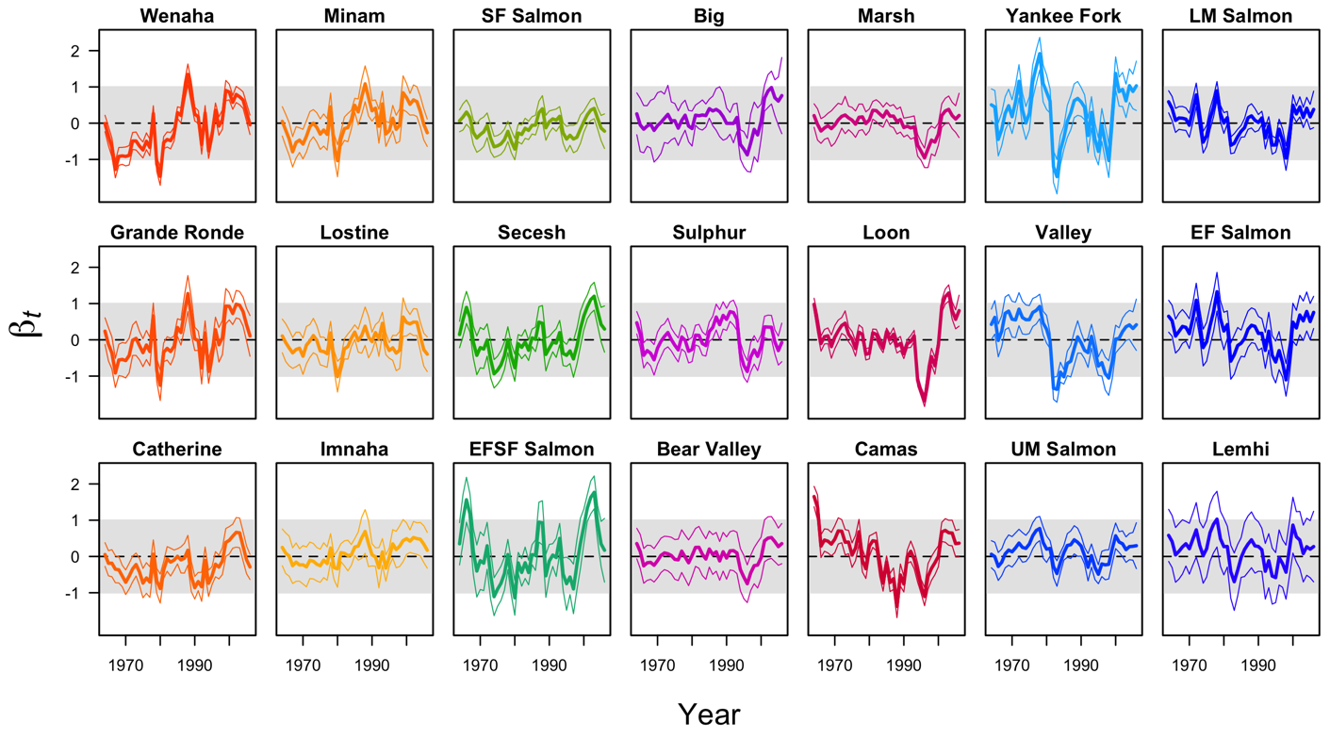
Results – time series of betas
Market = PDO

Slide 60
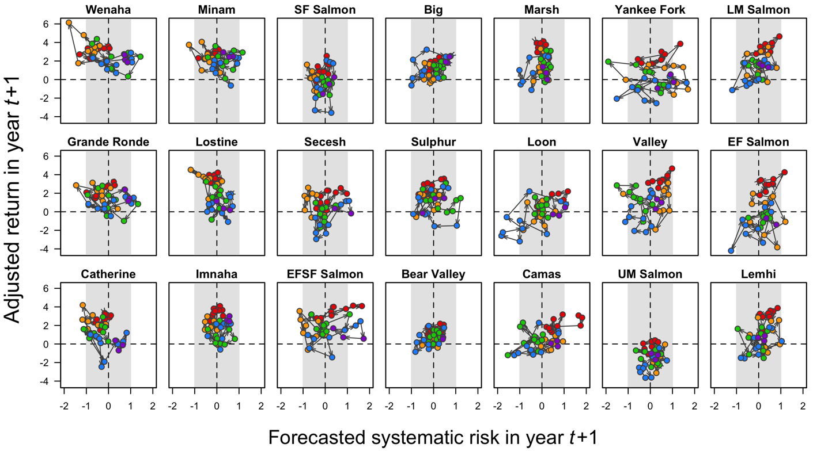
Results – CAPM
1960s
1970s
1980s
1990s
2000s
Market = PDO; Risk-free = 0

